Slide 1

Two stage Traffic sign detection using neural network
Vadlamani Neha
124004204
ECE/SEEE
Namburi Hema Harika
124004200
ECE/SEEE
Anushaa R
124004025
ECE/SEEE
Mr. Ramkumar S
Research Assistant
ECE/SEEE
SASTRA

Slide 2
Objective
To build a model for the classification of traffic signs using convolution neural networks(CNN)

Slide 3
Abstract
Traffic signs play a crucial role in managing traffic on the road, controlling the drivers, thereby preventing injury, property damage, and fatalities.
In this project we propose two-stage traffic sign detection system based on neural networks.
Detection and classification of traffic signs is done using CNN and deep learning algorithms and the PYNQ board is used to implement the algorithm in hardware.
It can be used in vehicles to provide real-time information about traffic signs. It helps drivers and driverless cars to make informed decisions and improve road safety.
The result of the project will show that the system can effectively detect and classify the traffic sign with high accuracy.

Slide 4




Methodology
Preprocessing Data:
Preprocess the dataset of traffic sign images to prepare it for training the CNN model.
Reading data from GTSRB.
Resizing the images (30,30).
Splitting the images as training and testing datasets.
Some pictures used for Training and Testing

Slide 5
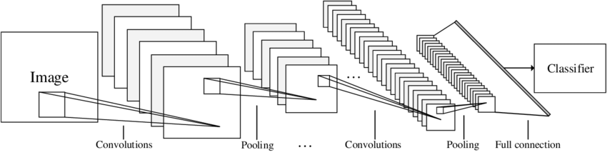
Model Design:
Performing 4 layers of convolution with various filter sizes and activation methods.
Max pooling is used after convolution for down sampling the images.
Dropout is used for dropping out the nodes to prevent overfitting.
Flatten converts the 3D matrix to 1D vector.

Slide 6
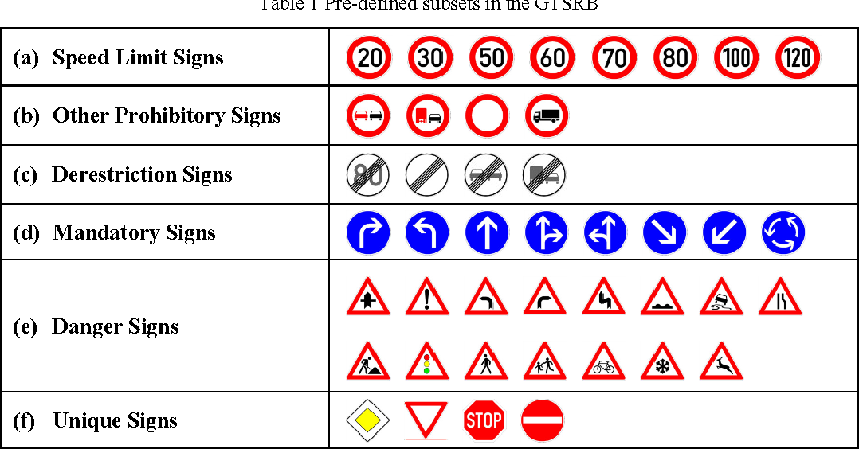
Model Training:
The preprocessed dataset is used to train the CNN model.
During the training process, the model parameters are updated by iterating through the dataset multiple times.
This helps to minimize the loss function and to improve accuracy.

Slide 7
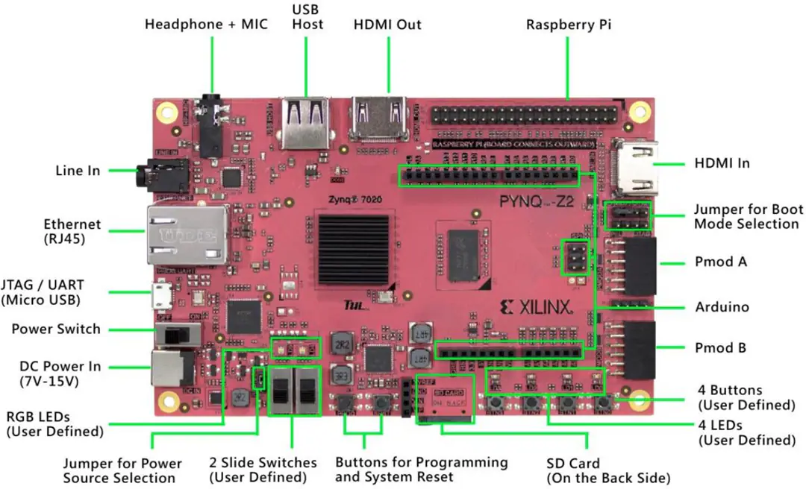
About PYNQ-Z1
PYNQ (Python + ZYNQ) board is designed to be programmed using python.
A powerful platform for implementing machine learning algorithms.
The board features a Xilinx Zynq-7000 SoC.
This board includes ethernet, USB, HDMI and a microSD card slot.
Enables developers to program the board using Python and Jupyter Notebooks.
Has access to pre-built libraries for machine learning techniques.

Slide 8
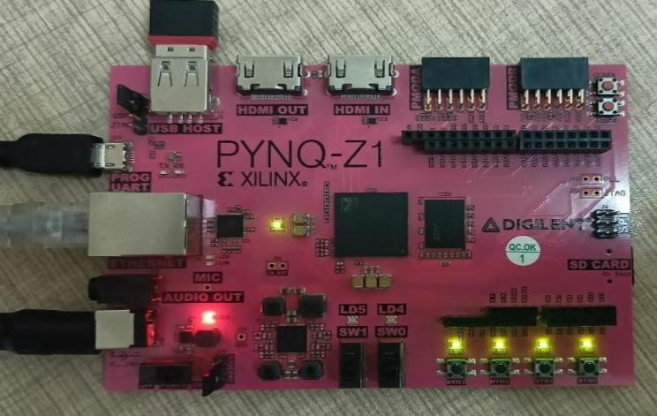
Hardware Implementation:
Power the PYNQ-Z1 from the micro USB cable.
Insert the Micro SD card loaded with the PYNQ-Z1 image.
Connect the PYNQ-Z1 to computer’s ethernet port.
Switch on the board and connect to Jupyter Notebook.
We have used Logitech 64 MP camera which is used to capture real time traffic sign images as input and given to PYNQ-Z1 board for further classification.

Slide 9
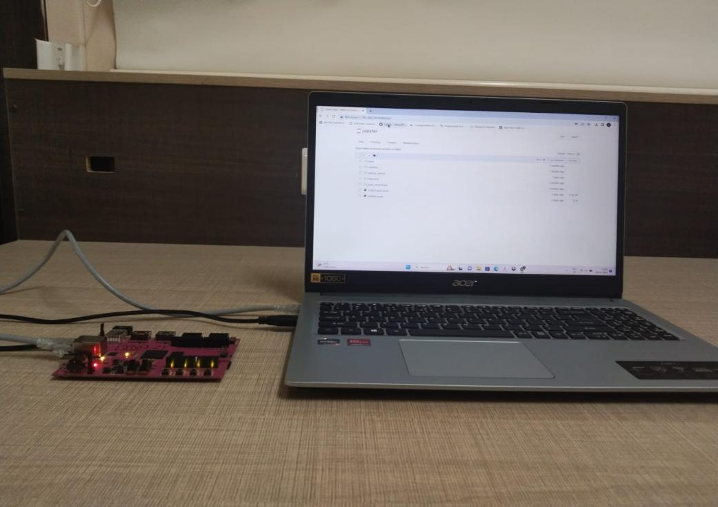
Computer connected to PYNQ-Z1 Board

Slide 10
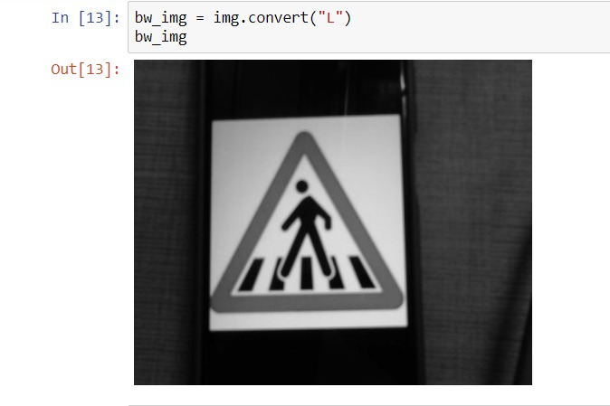
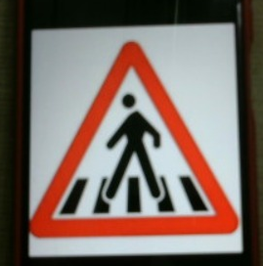
Accessing the Camera:
Connect the web camera in the USB port.
Run the webcam.py file.
Captures the image, converts to grey scale.

Slide 11
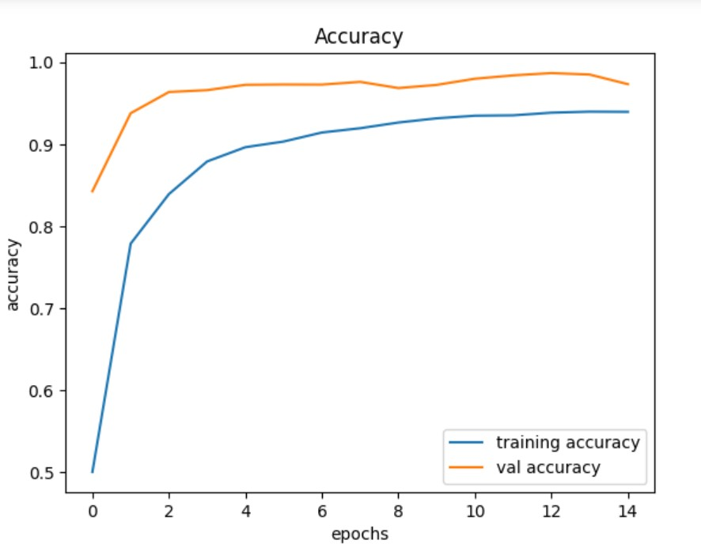
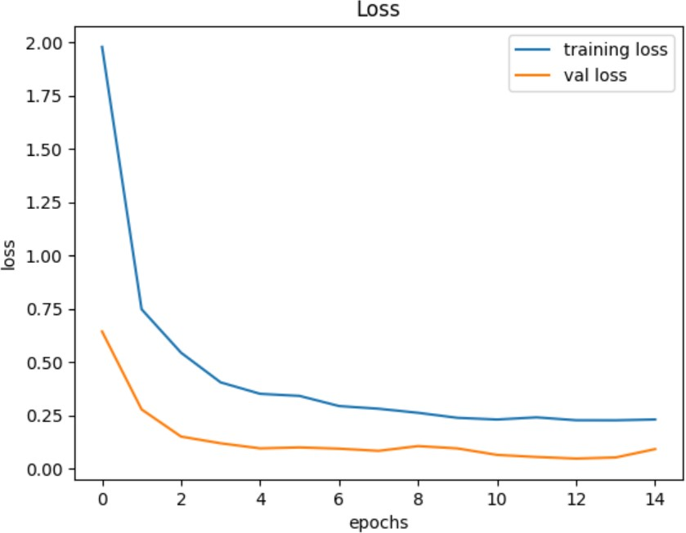
Results We have obtained an accuracy of 93%
.
Accuracy Graph
Loss Graph

Slide 12
Conclusion
It is an effective way to accurately recognize and classify road signs in real time.
In the first phase of detection, a pre-trained object recognition model is used to detect possible traffic signs in an image or video frame.
In the second step, a previously trained classification model is used to accurately classify the detected traffic signs.
Trained and tested the GTSDB dataset with various epoch values and analyzed the corresponding accuracy values.
This approach can improve the safety of autonomous vehicles and human-driven vehicles by providing accurate and timely information about traffic signs.

Slide 13
Future Scope
Based on the Results:
The dataset can be increased to get more accurate results. This could be achieved through advancements in data augmentation techniques, larger and more diverse training datasets, and improvements in the use of transfer learning and pre-trained models. Collecting data from different Environment.

Slide 14
References
Bangquan.X and Xiao Xiong.W, "Real-Time Embedded Traffic Sign Recognition Using Efficient Convolutional Neural Network," in IEEE Access, vol. 7, pp. 53330-53346, 2019, doi: 10.1109/ACCESS.2019.2912311.
Galvez.R.L,Bandala.A.A,Dadios.E.P, Vicerra.R.R.P and Maningo.J.M.Z, "Object Detection Using Convolutional Neural Networks," TENCON 2018 - 2018 IEEE Region 10 Conference, Jeju, Korea (South), 2018, pp. 2023-2027, doi: 10.1109/TENCON.2018.8650517.
Hmidani.O and Ismaili Alaoui.E.M, "A comprehensive survey of the R-CNN family for object detection," 2022 5th International Conference on Advanced Communication Technologies and Networking (CommNet), Marrakech, Morocco, 2022, pp. 1-6, doi: 10.1109/CommNet56067.2022.9993862.
Houben.S, Stallkamp.J,Salmen.J,Schlipsing.M, and Igel.C, “Detection of traffic signs in real-world images: The German traffic sign detection benchmark,” in Proc. IEEE Int. Joint Conf. Neural Netw., Aug. 2013, pp. 1–8.
Li.J and Wang.Z, "Real-Time Traffic Sign Recognition Based on Efficient CNNs in the Wild," in IEEE Transactions on Intelligent Transportation Systems, vol. 20, no. 3, pp. 975- 984, March 2019, doi: 10.1109/TITS.2018.2843815.
Liu.Z, Du.J, Tian.F and Wen.J, "MR-CNN: A Multi-Scale Region-Based Convolutional Neural Network for Small Traffic Sign Recognition," in IEEE Access, vol. 7, pp. 57120- 57128, 2019, doi: 10.1109/ACCESS.2019.2913882.
Santos.D.C et al., "Real-Time Traffic Sign Detection and Recognition using CNN," in IEEE Latin America Transactions, vol. 18, no. 03, pp. 522-529, March 2020, doi: 10.1109/TLA.2020.9082723.
Vennelakanti.A, Shreya.S, Rajendran.R, Sarkar.D,Muddegowda.D and Hanagal.P, "Traffic Sign Detection and Recognition using a CNN Ensemble," 2019 IEEE International Conference on Consumer Electronics(ICCE), Las Vegas, NV, USA, 2019, pp. 1-4, doi:10.1109/ICCE.2019.8662019.

Slide 15


